Slide 1

Meeting Minutes
Printed records for weekly formal meetings

Slide 2
Project Report
Think different, make perfect, we did

Slide 3

Unsolved Problems
Stay hungry, stay foolish, as always

Slide 4

Project Schedule
See what we have done so far in detail
Notes:
rawpixel-714362-unsplash.jpg

Slide 5
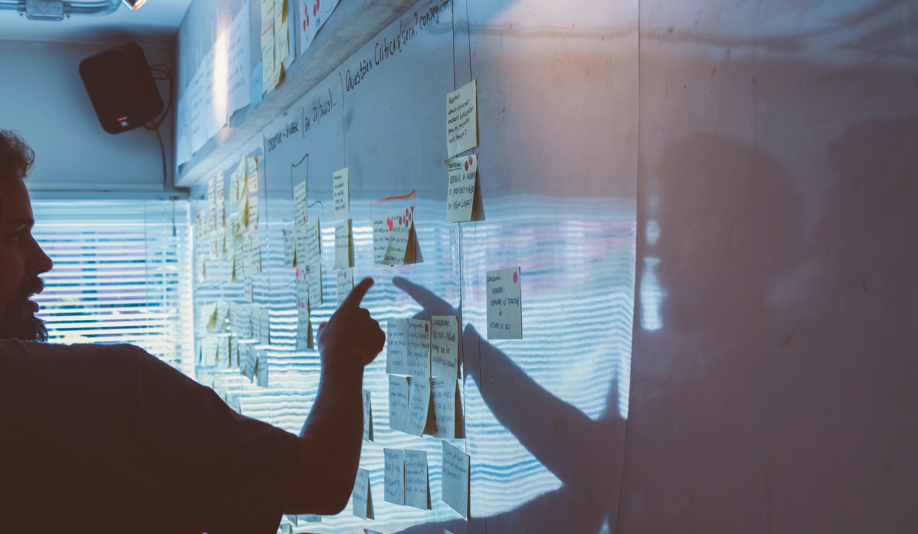
Important Dates
Precious dates and activities, never miss
Notes:
rawpixel-714362-unsplash.jpg

Slide 6

Weekly Photos
Splendid moments, brighter than ever
Notes:
rawpixel-714362-unsplash.jpg

